Slide 1




Ultimaze
Group8B
Juliette FLORIN, Clément RICHARD, Haoran ZENG, Aurélien BRUN, Romain GEORGENTHUM

Slide 2




ULTIMAZE
24/11/2022 -
- p 1

Slide 3
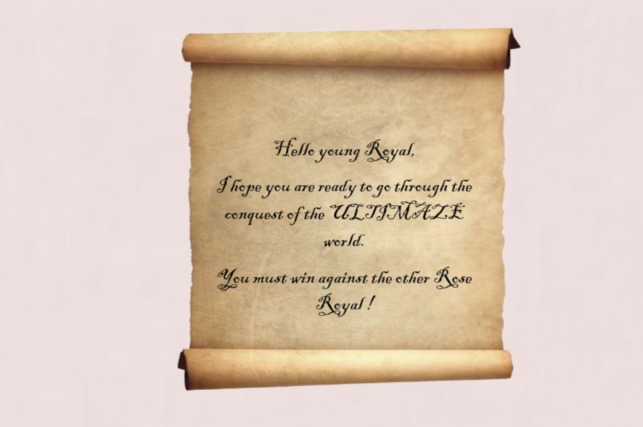
ULTIMAZE World
24/11/2022 -
- p 2

Slide 4

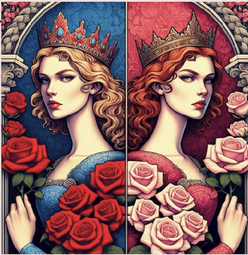
The World
Matriarchy
24/11/2022 -
- p 3

Slide 5
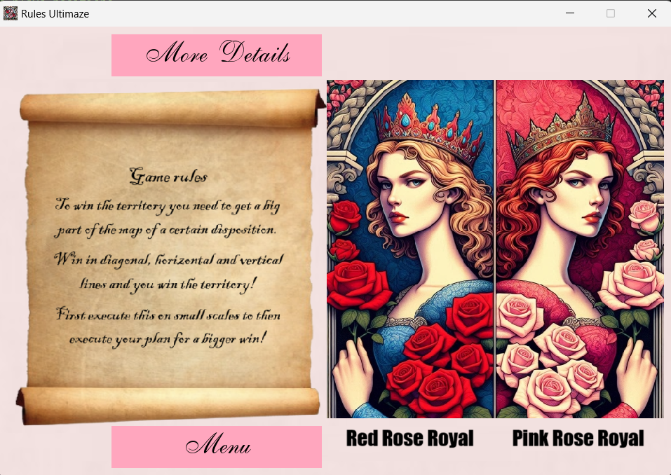
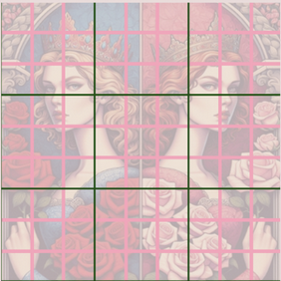
Game rules
24/11/2022 -
- p 4

Slide 6
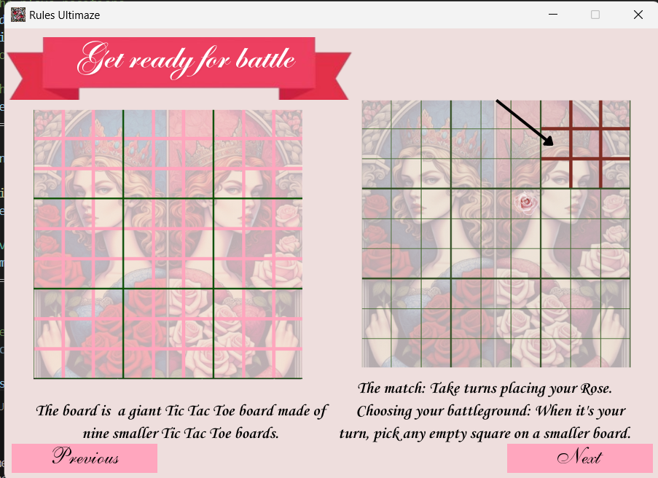
24/11/2022 -
- p 5

Slide 7
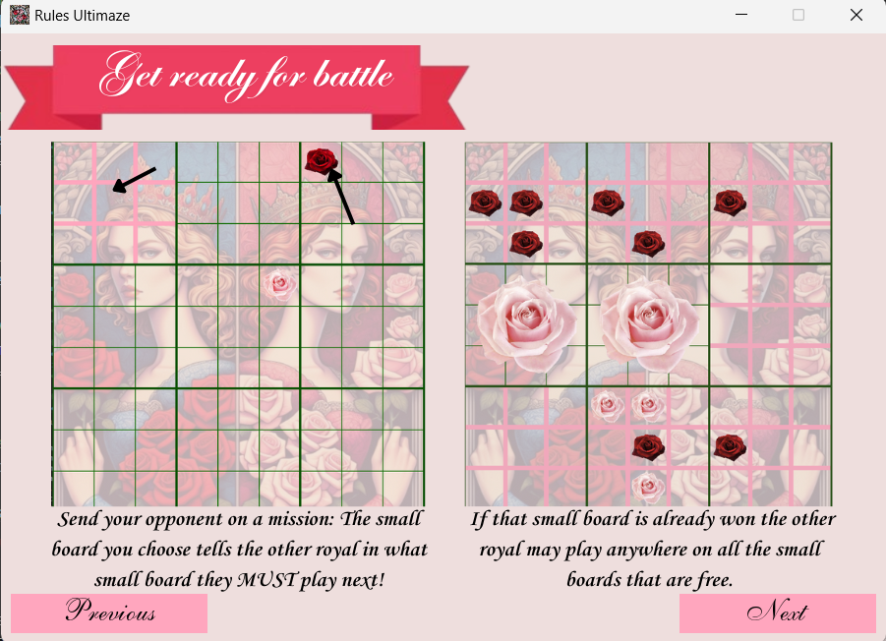
24/11/2022 -
- p 6

Slide 8
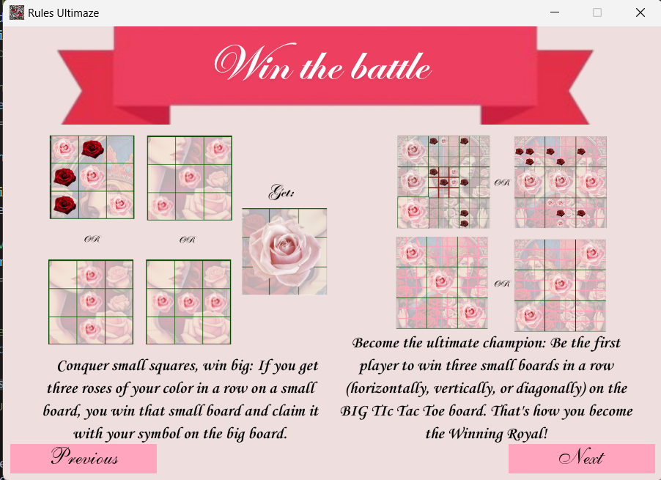
24/11/2022 -
- p 7

Slide 9
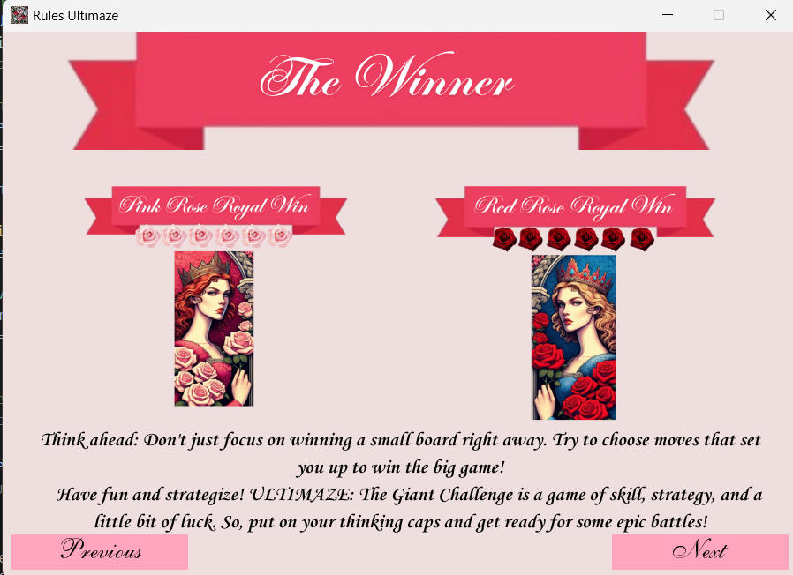
24/11/2022 -
- p 8

Slide 10
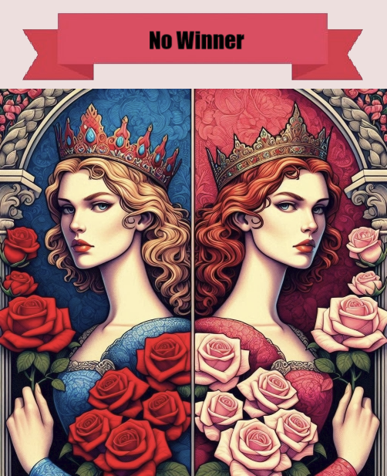
Winning ?
Be careful!
War is a conflict where sometimes everyone loses .
24/11/2022 -
- p 9

Slide 11
Game play
24/11/2022 -
- p 10

Slide 12
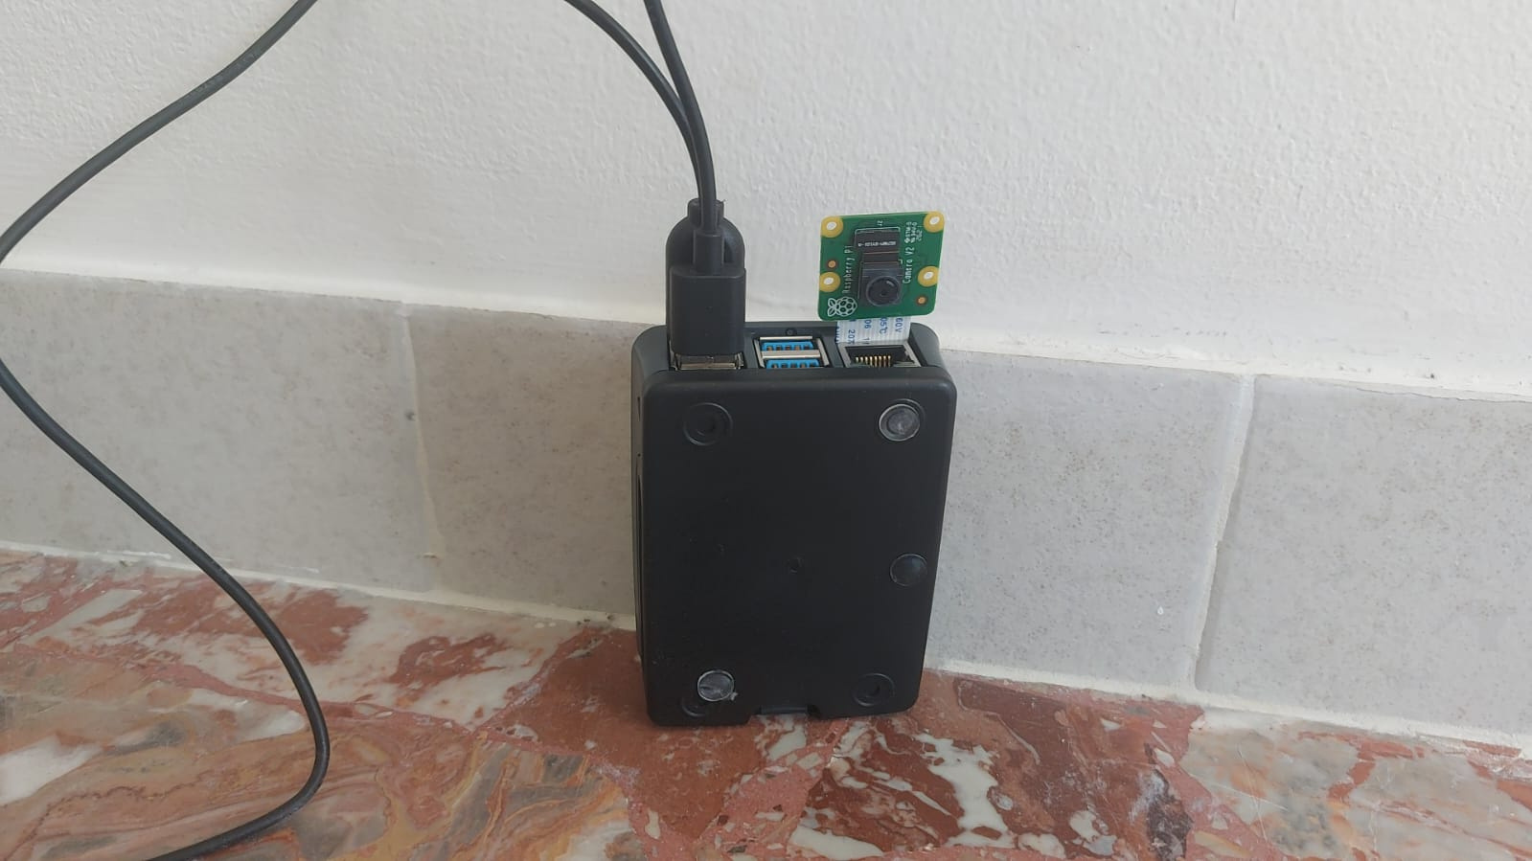
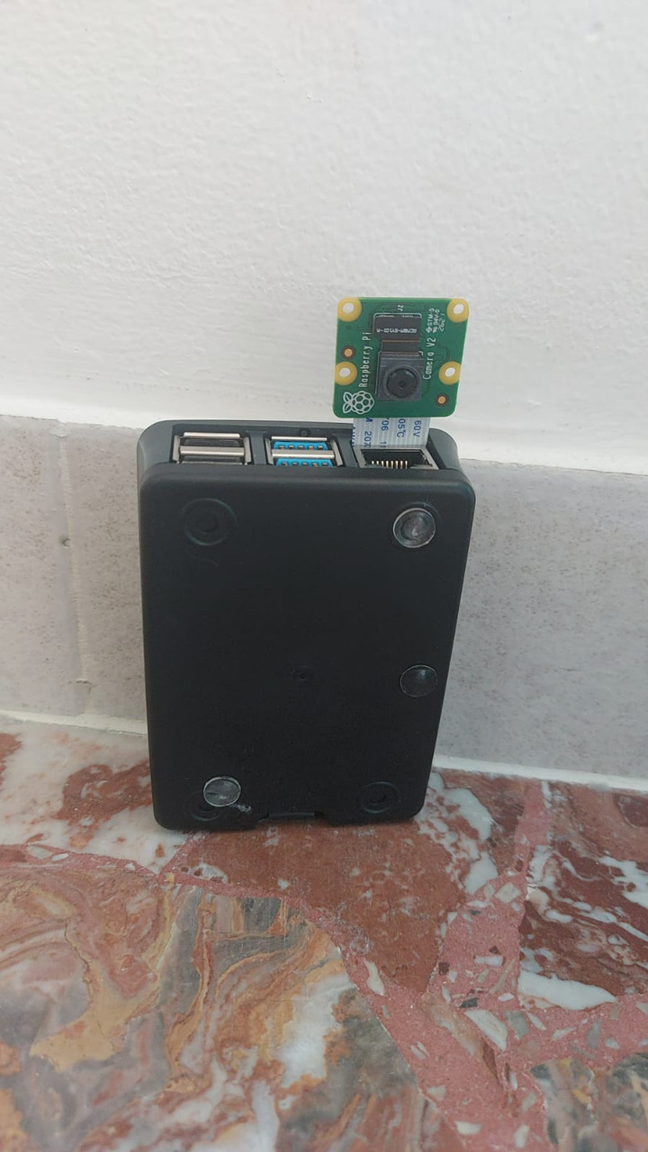
The device
24/11/2022 -
- p 1 1

Slide 13



24/11/2022 -
- p 1 2

Slide 14
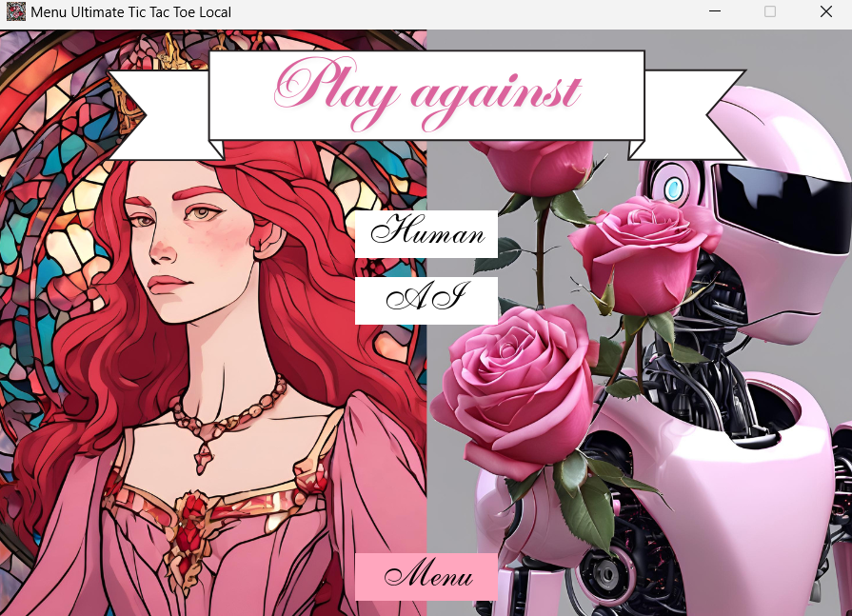
Local
On the same device
Multi-player...
Our bot
24/11/2022 -
- p 1 3

Slide 15
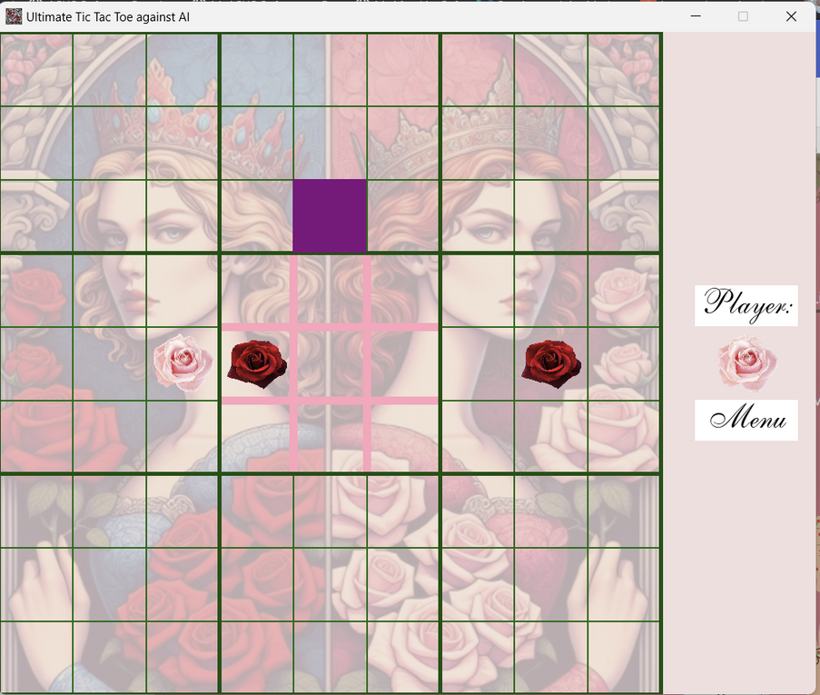
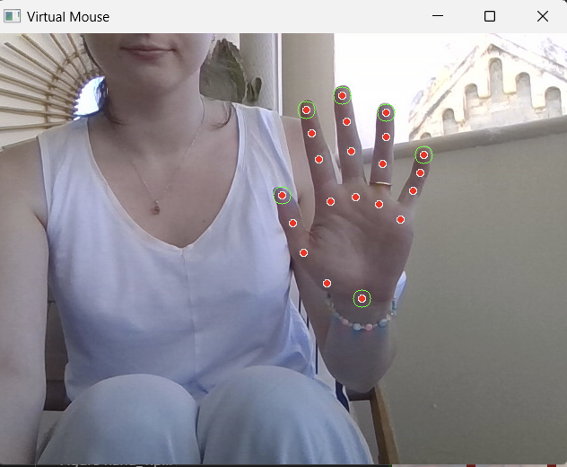
No mouse
24/11/2022 -
- p 1 4

Slide 16
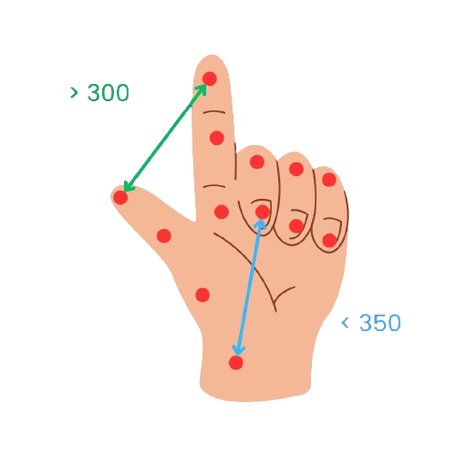
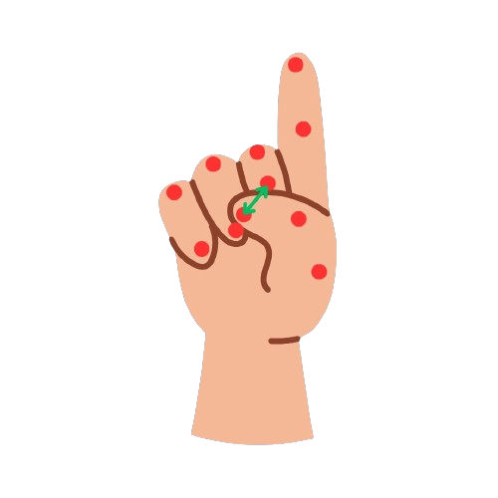
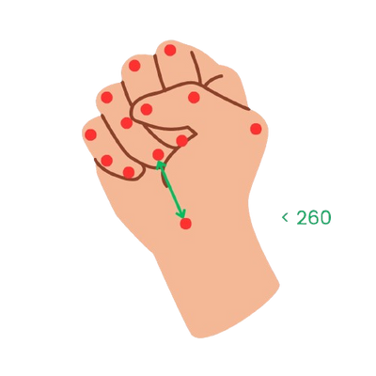
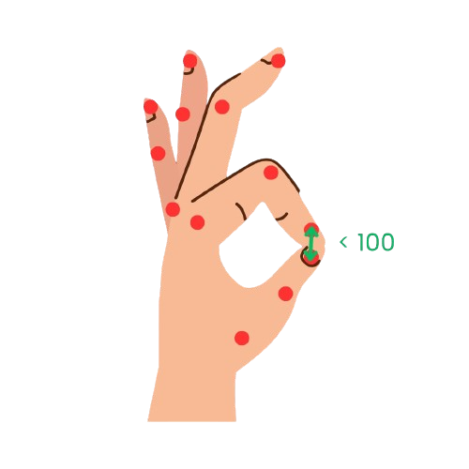
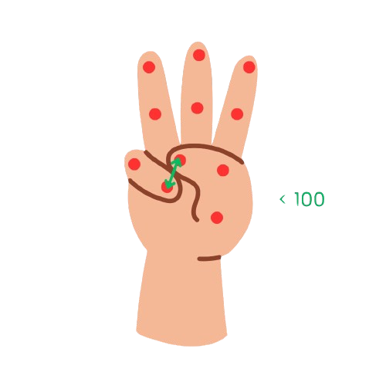

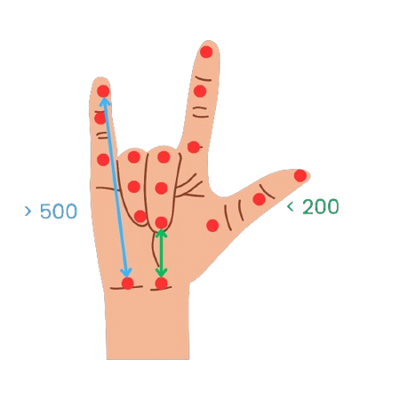
Hand gestures
24/11/2022 -
- p 1 5

Slide 17

Super Bot
Max 10s
24/11/2022 -
- p 16

Slide 18
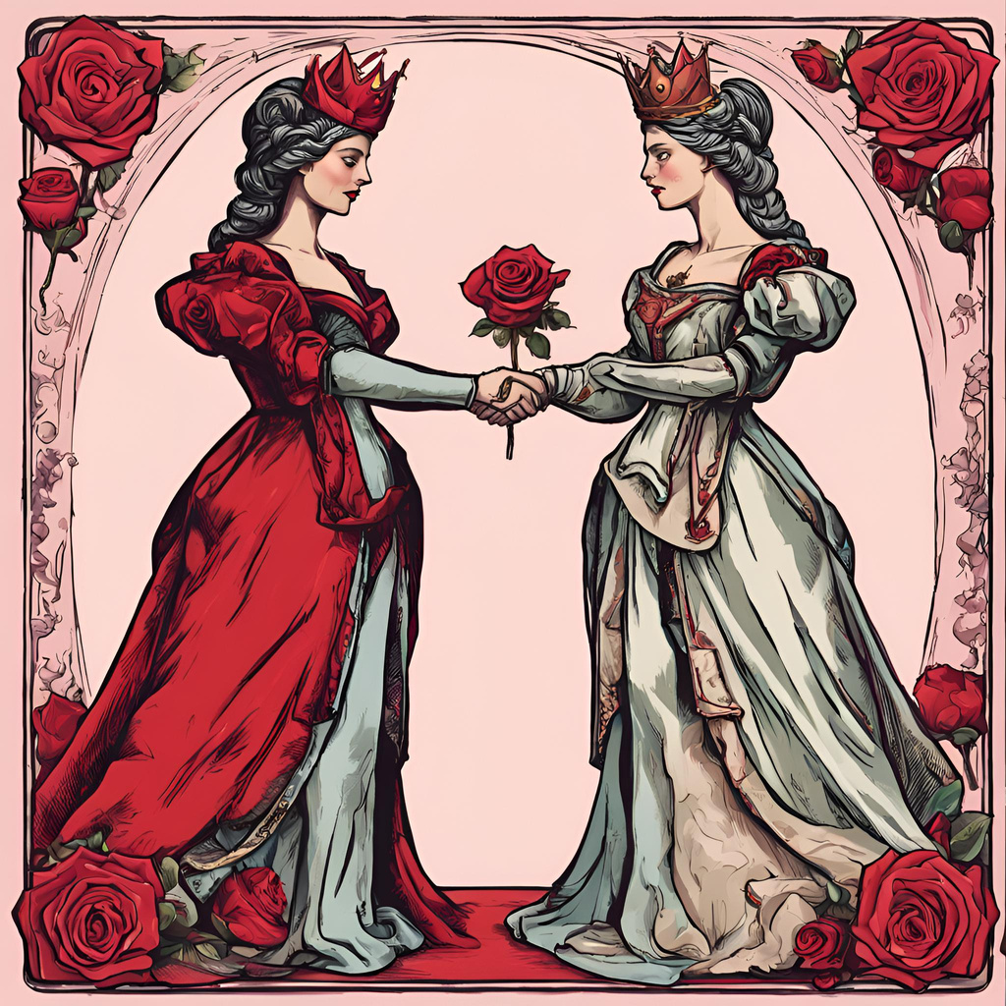
Online
Find another Royal
24/11/2022 -
- p 1 7

Slide 19

Online
Exchange information:
ip
port
who starts (who host who joins)
Join == starts
24/11/2022 -
- p 1 8

Slide 20
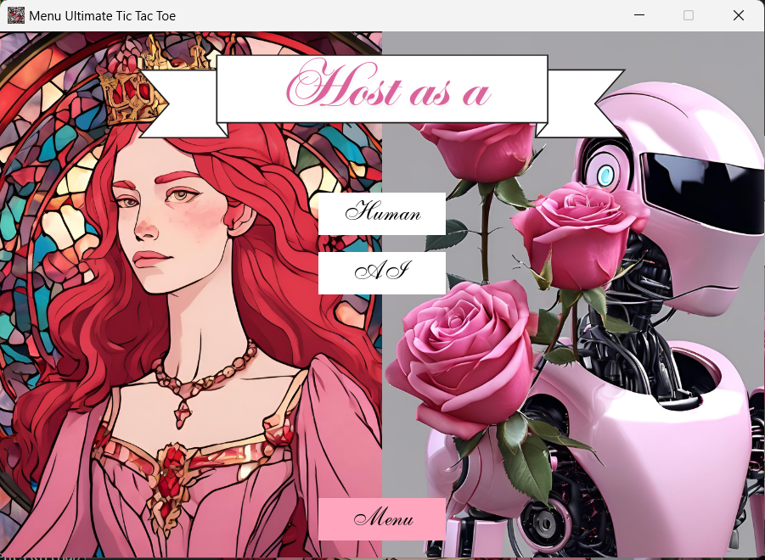
Online: choose who is on the battle field
24/11/2022 -
- p 1 9

Slide 21
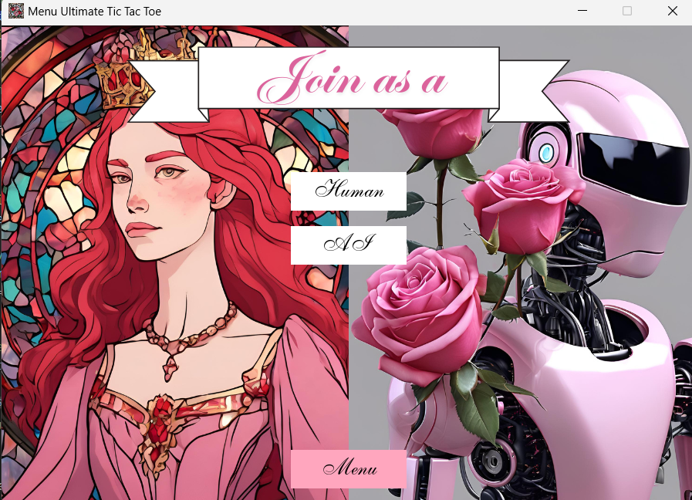
Online: choose who is on the battle field
24/11/2022 -
- p 20

Slide 22
Thank you
Come and fight for your rose realm!
24/11/2022 -
- p 21

Slide 23
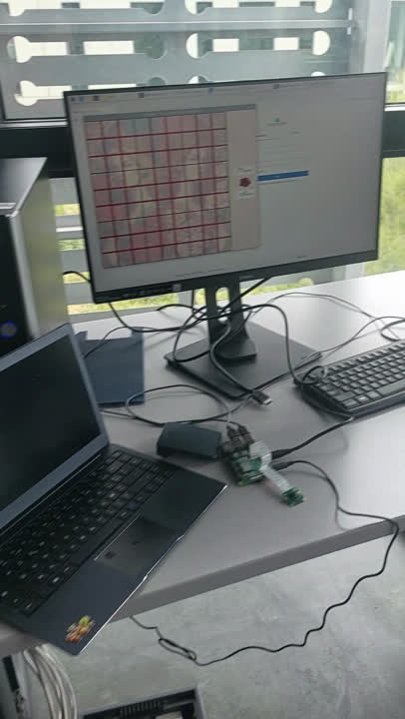
Battle
24/11/2022 -
- p 22

